Slide 1
Week 5
Assignment：Center Selection
Name：张颜兵
Id：12132428
Department：MAE
SuperVisor：Prof.吴雷
Research Topic：Engineering calculation

Slide 2

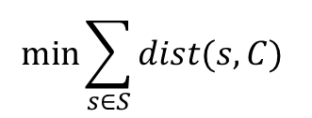
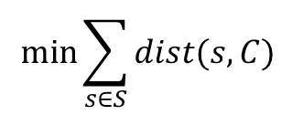
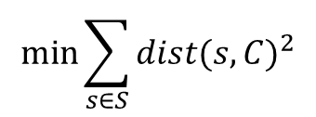
E1
$$min\max_{s∈S}{dist(s,C)}$$
0 1 2 3 4 5 6 7 8 9 10 11 12 13 14 15 16 17 18 19 20
$$min\sum_{s∈S}{dist{(s,C)}^{2}}$$
0 1 2 3 4 5 6 7 8 9 10 11 12 13 14 15 16 17 18 19 20
$$min\sum_{s∈S}{dist(s,C) }$$
0 1 2 3 4 5 6 7 8 9 10 11 12 13 14 15 16 17 18 19 20
$$min\sum_{s∈S}{dist(s,C) }$$
0 1 2 3 4 5 6 7 8 9 10 11 12 13 14 15 16 17 18 19 20

Slide 3

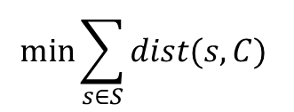
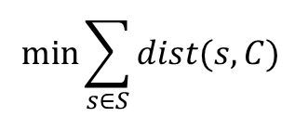
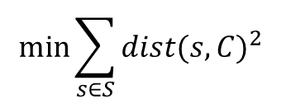
E2
$$min\max_{s∈S}{dist(s,C)}$$
0 1 2 3 4 5 6 7 8 9 10 11 12 13 14 15 16 17 18 19 20
$$min\sum_{s∈S}{dist{(s,C)}^{2}}$$
0 1 2 3 4 5 6 7 8 9 10 11 12 13 14 15 16 17 18 19 20
$$min\sum_{s∈S}{dist(s,C) }$$
0 1 2 3 4 5 6 7 8 9 10 11 12 13 14 15 16 17 18 19 20
$$min\sum_{s∈S}{dist(s,C) }$$
0 1 2 3 4 5 6 7 8 9 10 11 12 13 14 15 16 17 18 19 20

Slide 4

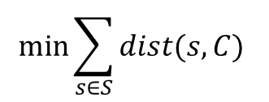
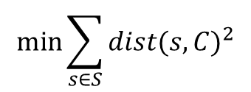
E3
$$min\max_{s∈S}{dist(s,C)}$$
0 1 2 3 4 5 6 7 8 9 10 11 12 13 14 15 16 17 18 19 20
$$min\sum_{s∈S}{dist{(s,C)}^{2}}$$
0 1 2 3 4 5 6 7 8 9 10 11 12 13 14 15 16 17 18 19 20
$$min\sum_{s∈S}{dist(s,C) }$$
0 1 2 3 4 5 6 7 8 9 10 11 12 13 14 15 16 17 18 19 20

Slide 5

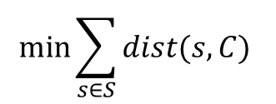
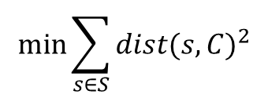
E4
$$min\max_{s∈S}{dist(s,C)}$$
0 1 2 3 4 5 6 7 8 9 10 11 12 13 14 15 16 17 18 19 20
$$min\sum_{s∈S}{dist{(s,C)}^{2}}$$
0 1 2 3 4 5 6 7 8 9 10 11 12 13 14 15 16 17 18 19 20
$$min\sum_{s∈S}{dist(s,C) }$$
0 1 2 3 4 5 6 7 8 9 10 11 12 13 14 15 16 17 18 19 20

